Slide 1

Club Workshop
June 2025

Slide 2
Agenda
Time | Activity
9:30 | Registration
10:00 | Welcome from DGE Stuart Introductions Cabinet 2025-26 roles Theme for the year and communication modes | ALL
10:30 | Secretary training Treasurer training President training | Break into groups
11:00 | Break
11:10 | Communication Within district , Requesting support Signatures The portal and service reporting Resources - Learn Succession planning and leadership development
11:50 | Closing comments – Stuart | ALL
12:00 | Finish

Slide 3

Welcome
Housekeeping
The theme for this Lions year
Communication
  Google forms and how to manage
Cabinet executive

Slide 4
Communication
Google forms
How to keep a record of your correspondence
The role of the District

Slide 5
Cabinet Executive
DG – Stuart Perrett
1VDG – Johnson Chen
2VDG – Sophia Argyrou
Cab Secretary – Christine Cufflin
Cab Treasurer – Tim Trainor
CBL – PDG Ian Bruning

Slide 6
Club visits
DG team visit
Zone chair communication and visits
Suggested visit dates
Zone meetings and their purpose

Slide 7
Your club and success
Have an action plan for the year
  Membership
  Events
  Signature projects
Encourage members to shadow roles to learn
Visit other clubs to share ideas

Slide 8
Break into groups
Club President– Stuart
Club Treasurer – Tim Trainor
Club Secretary- Christine Cufflin
Some key things to keep in mind as you take on your role.

Slide 9

Morning tea

Slide 10
Lions Portal
Lions Learning Centre
The role of the GLT team

Slide 11

Lion Portal
Reports & Dashboards Cross Reference
MyLion/MyLCI → Lion Portal
June 1, 2024
11

Slide 12
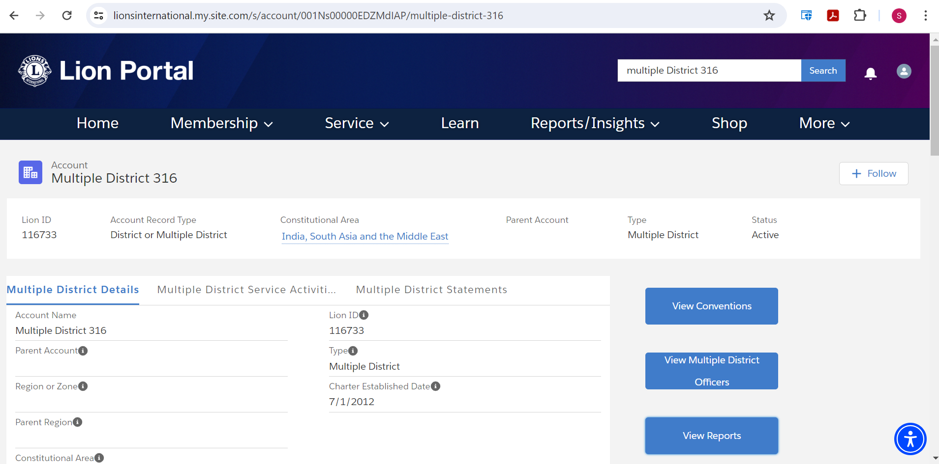
Report Locations – MyLCI to Lion Portal
At each level (Club, District, Multiple District, GAT) there was a drop down for reports specific to the level in MyLCI (across the gold bar at the top)
When you have navigated to the level, in this example it is Multiple District 316. Click the View Reports button to bring up the list of available reports at this level.
12

Slide 13
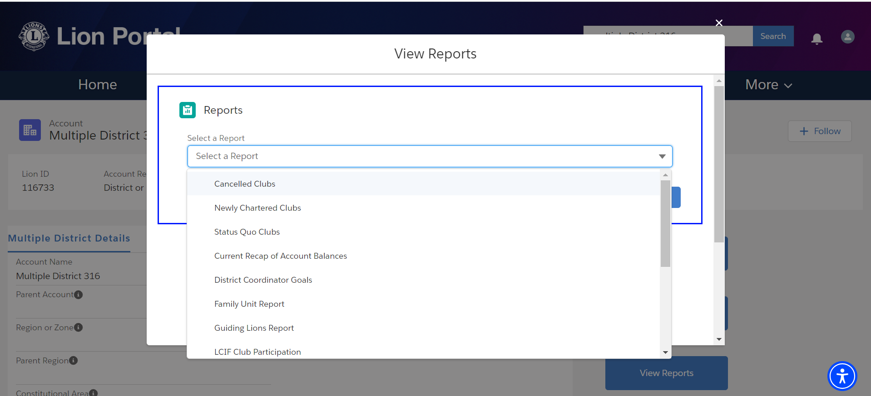
Report Locations – MyLCI to Lion Portal
The MyLCI report list is shown. If parameters are required, you will be asked to enter them after selecting the report
Select the report, it may be necessary to scroll down to see the full list
13

Slide 14
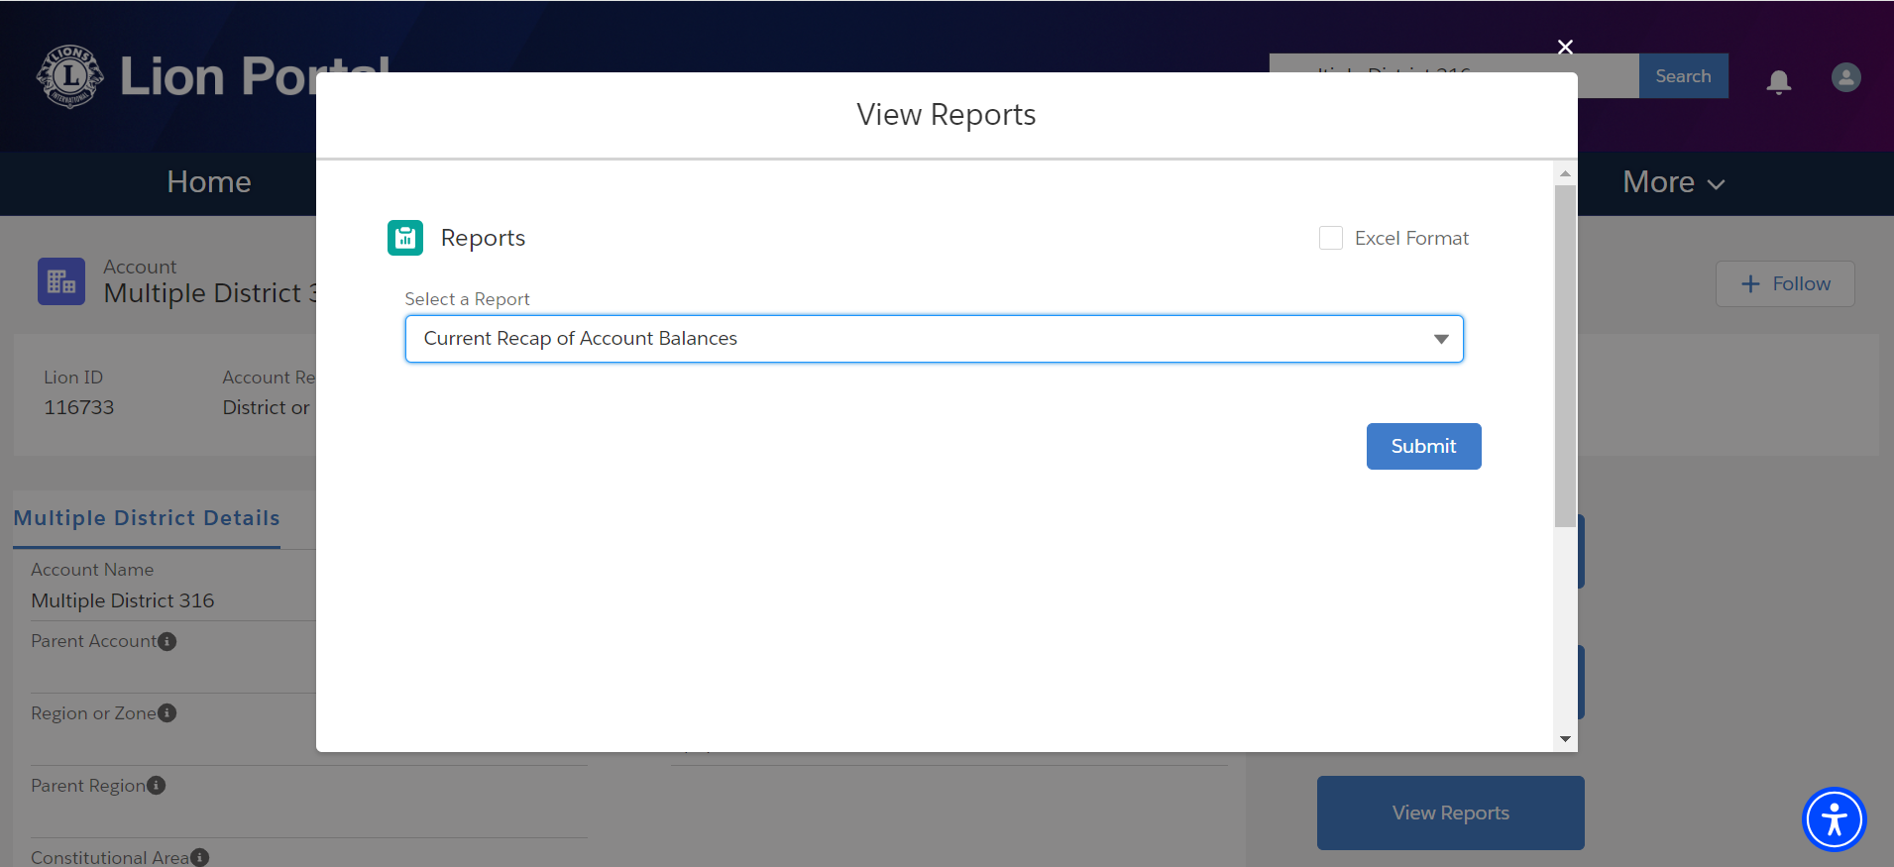
Report Locations – MyLCI to Lion Portal
As before there is the option for Excel format or .pdf
To export the report to Excel format, check the Excel Format box
14

Slide 15
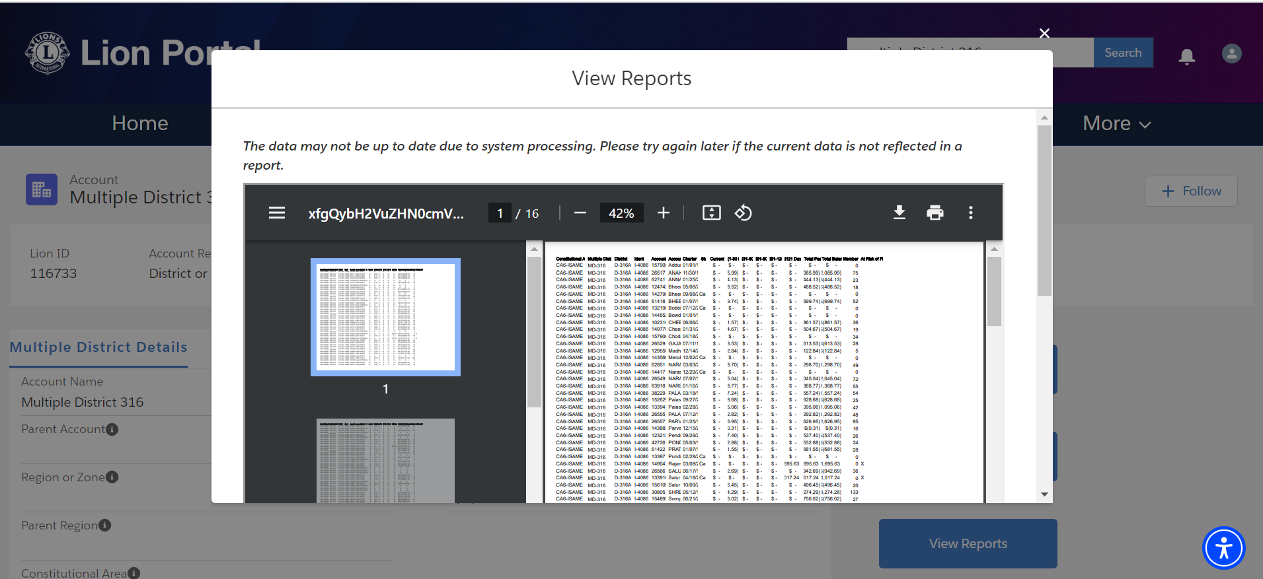
Report Locations – MyLCI to Lion Portal
If Excel format is NOT checked the default is .pdf format
From here you can
Print or
Download the pdf
15

Slide 16
Report Locations – MyLCI to Lion Portal
Reports available at the Club level
Report Name | Report Name
Club Achievements | Family Unit Report
Club Attendance | Lions Club Contact List
Club Monthly Reporting History | Lions Club Officer Report For Next Year
Lions Club Officer Report for Current Year | Membership Information Update Report
Club Roster | Monthly Membership Report - Detail
Club Roster of Membership Data
Lions District Officer Contact List
16

Slide 17

Locating Other Reports & Dashboards
Insights / KPI Reports / Membership Reports

Slide 18
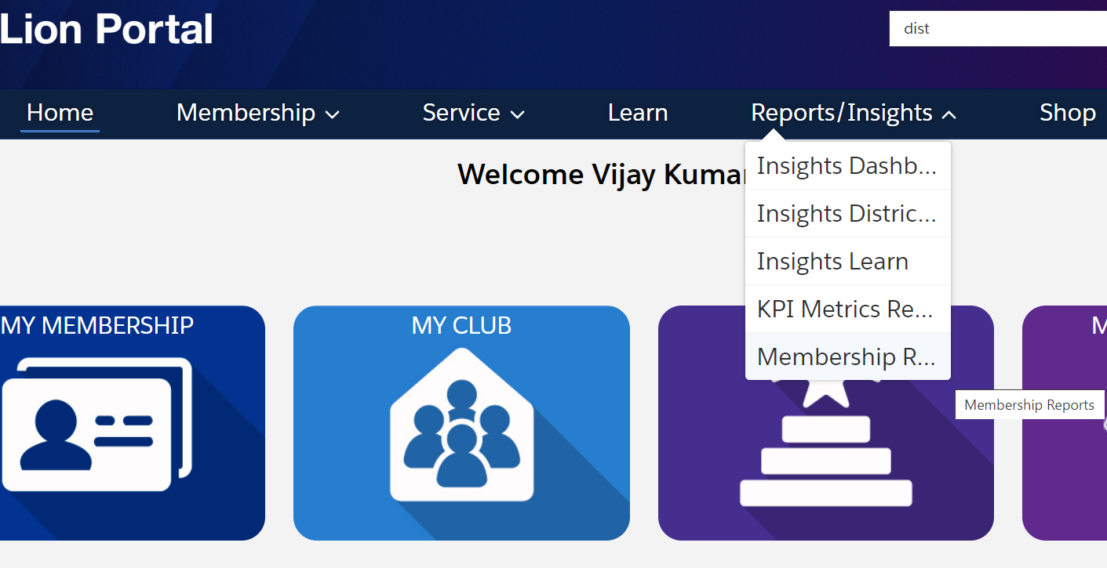
Dashboards & Reports
The Reports/Insight Menu
The list of options is expanded.
The list uses the terms previously used.
18

Slide 19
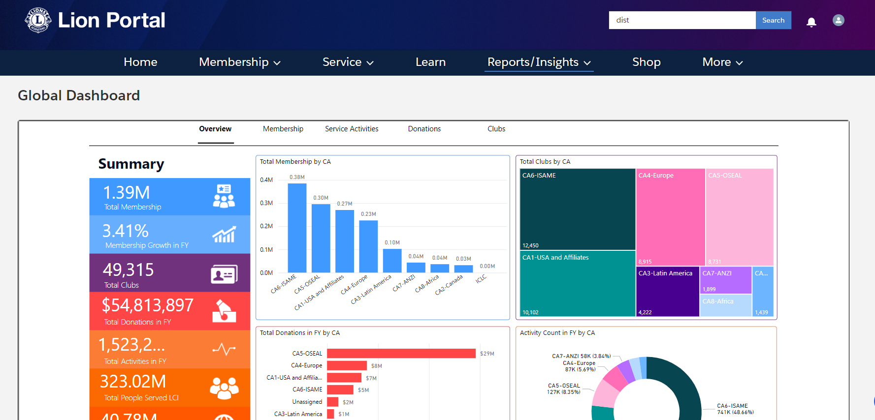
Other Available Dashboards & Reports
Insights Dashboard (First Menu Item)
The Global Dashboard is displayed.
All previous features are available.
19

Slide 20
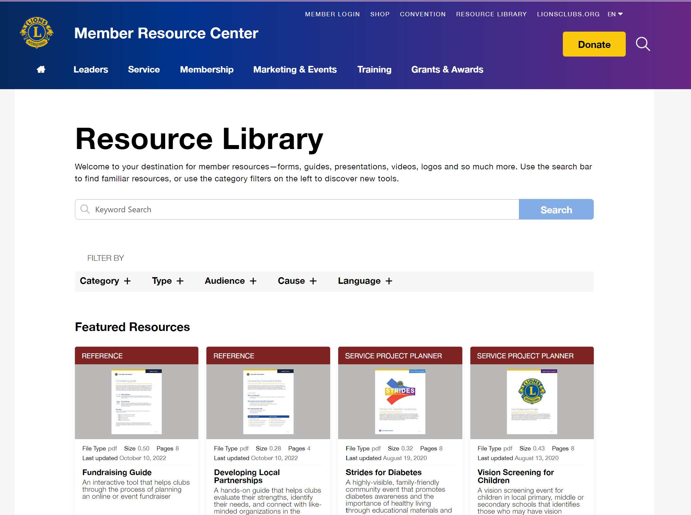
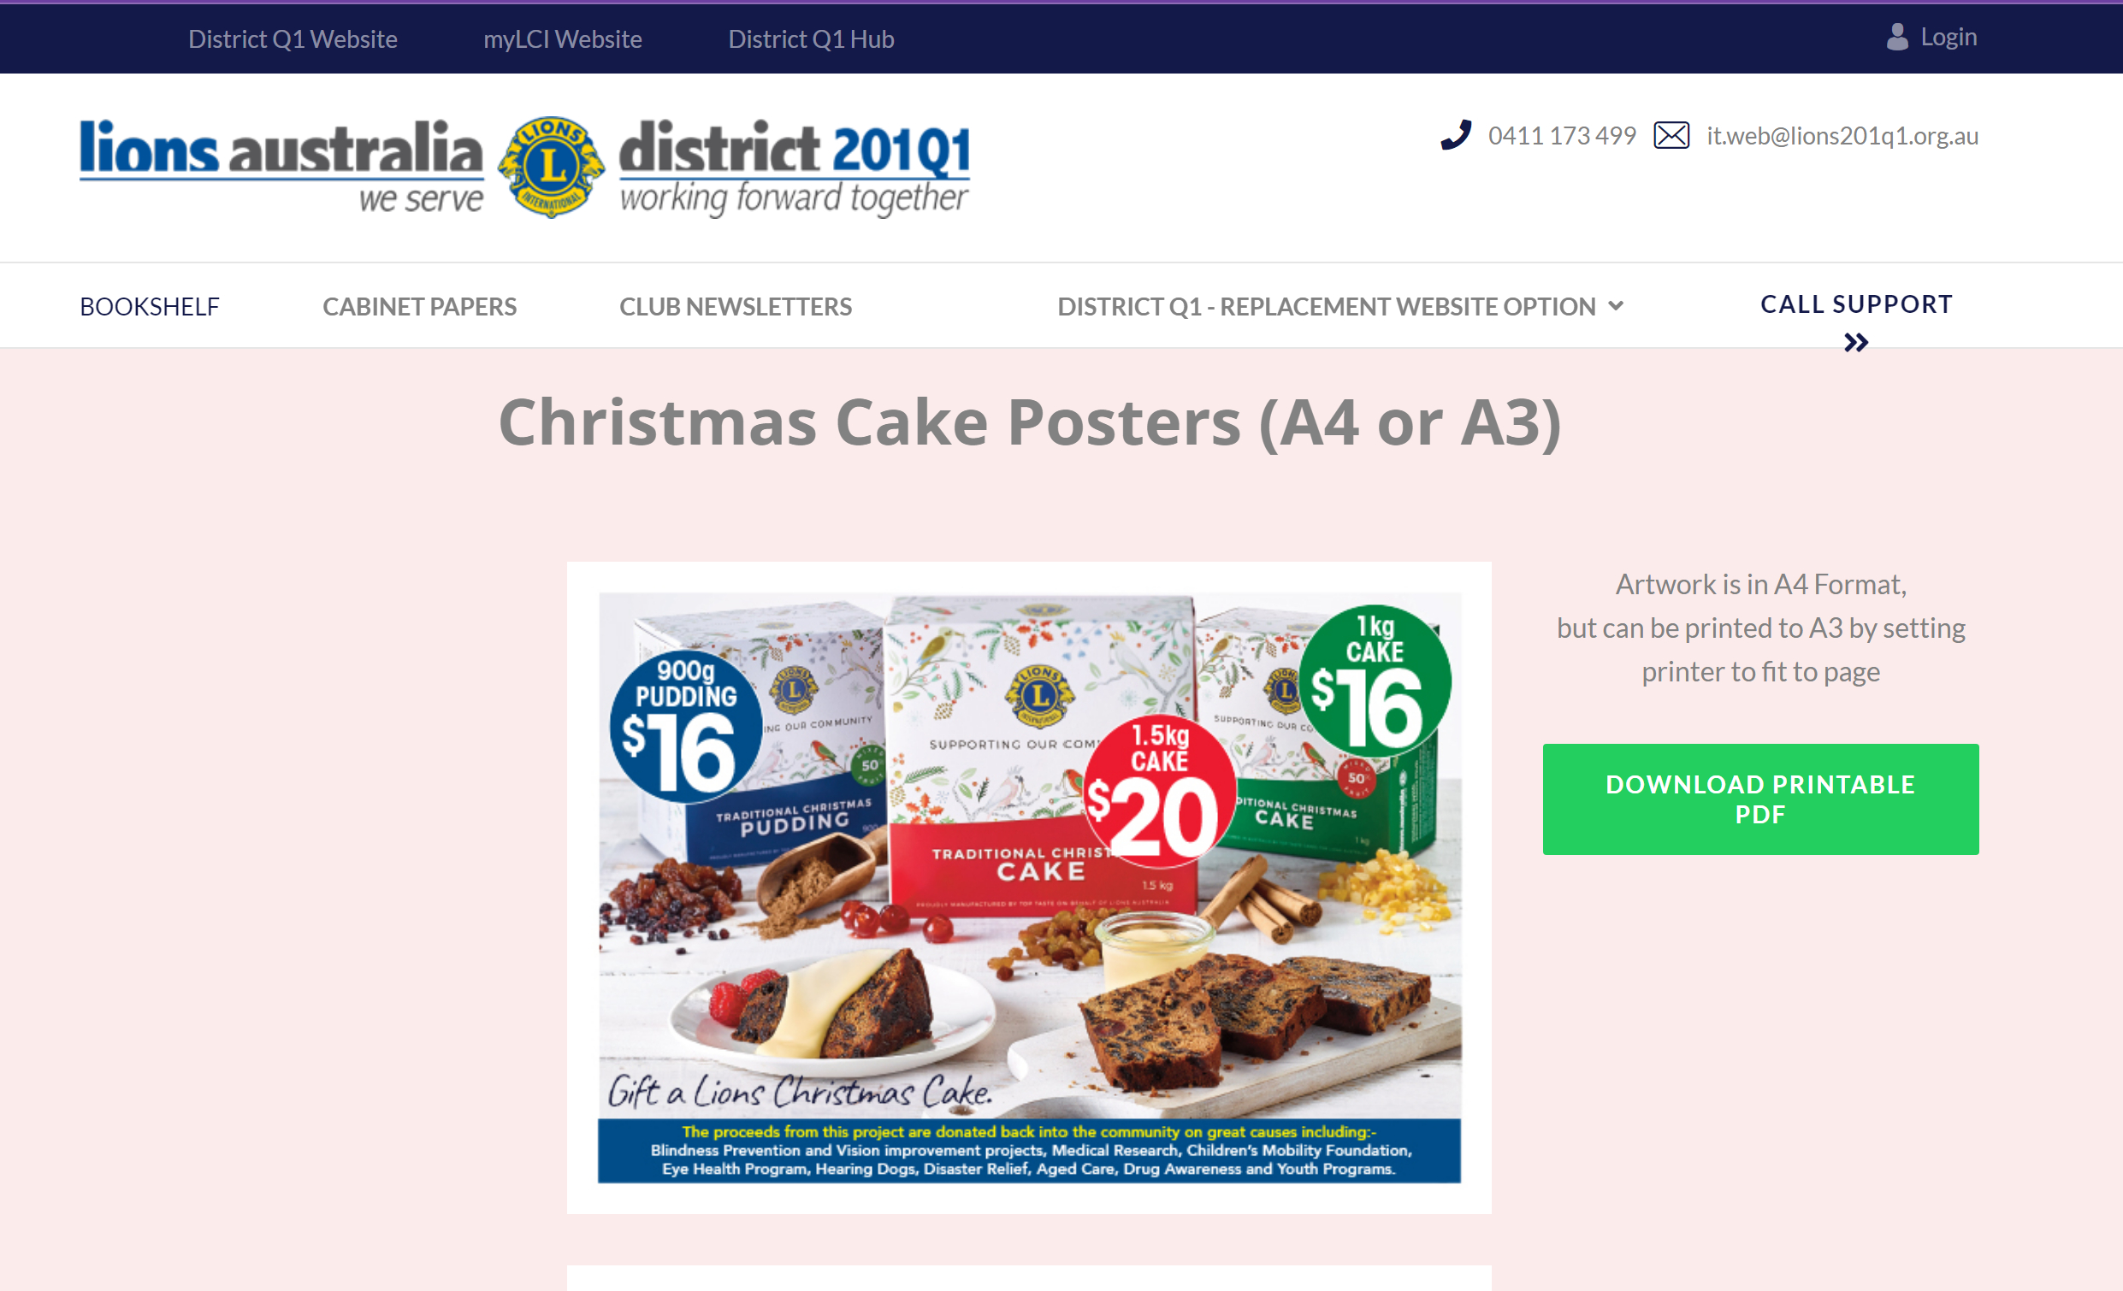
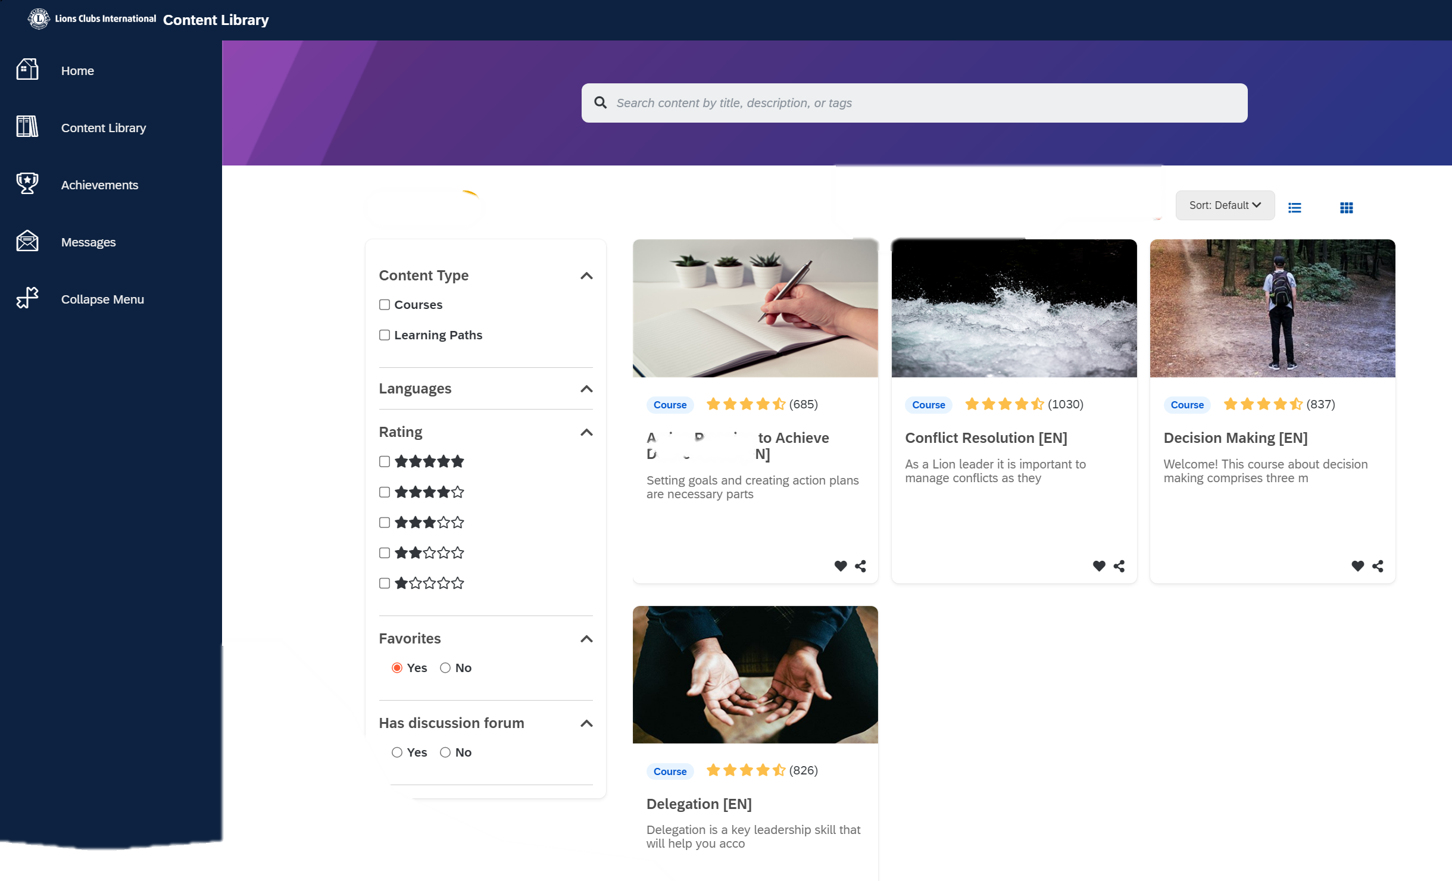
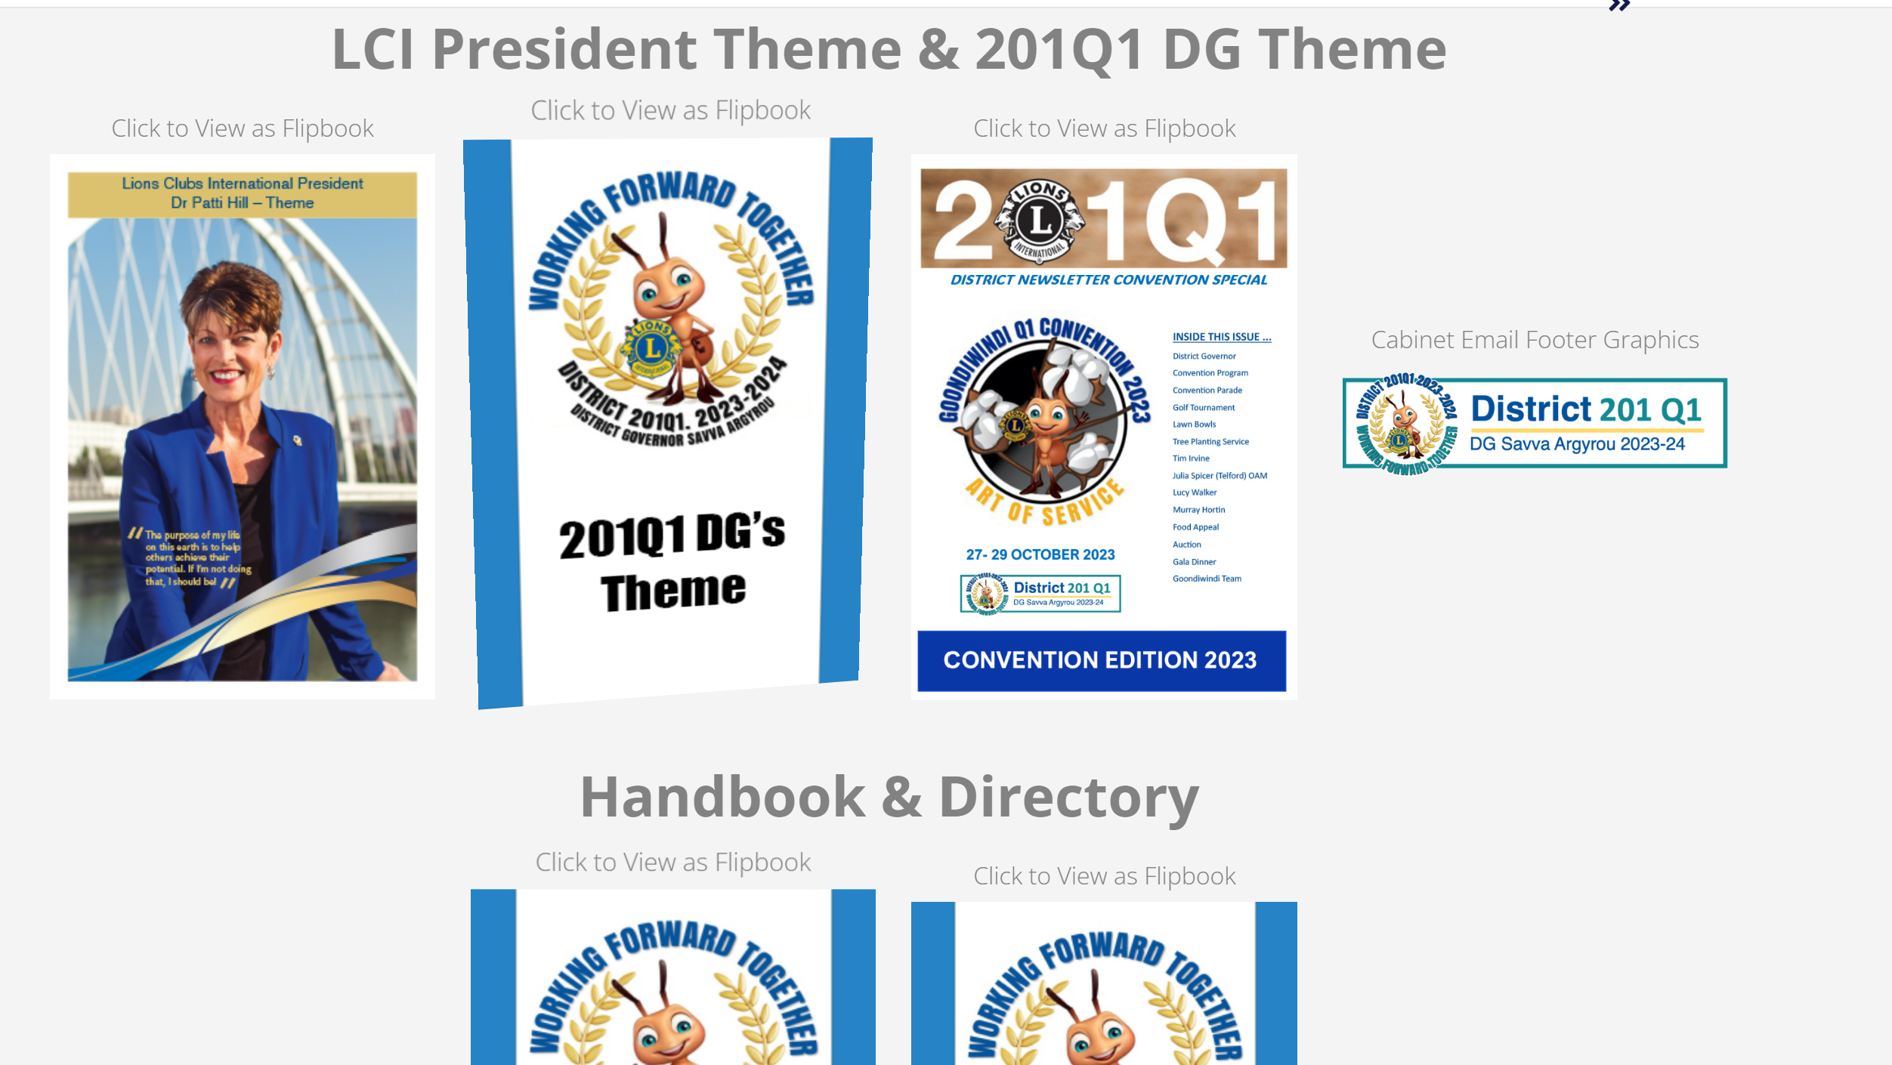
Resources and support
MyLion - Learning Centre
Resource Library
Bookshelf
Q1 Website
Q1 Hub

Slide 21
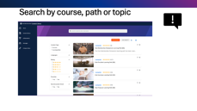
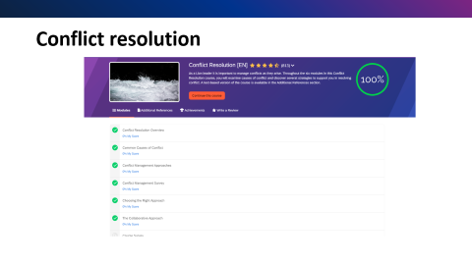
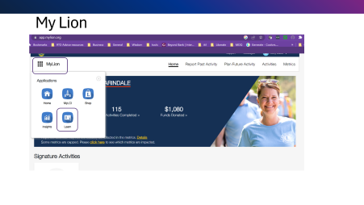
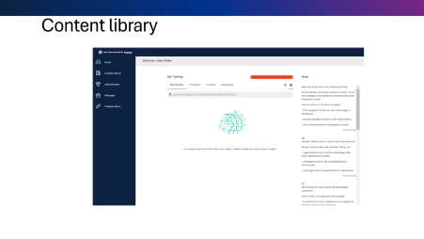


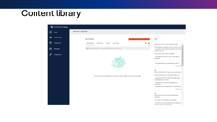
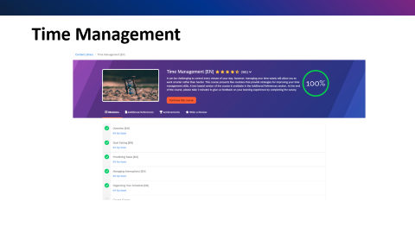
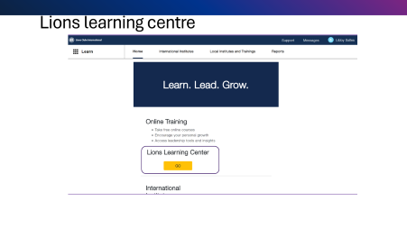
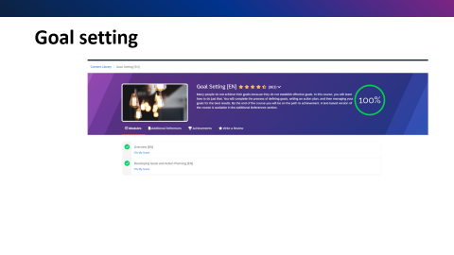

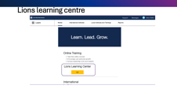

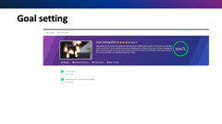
Lions Learning Centre

Slide 22
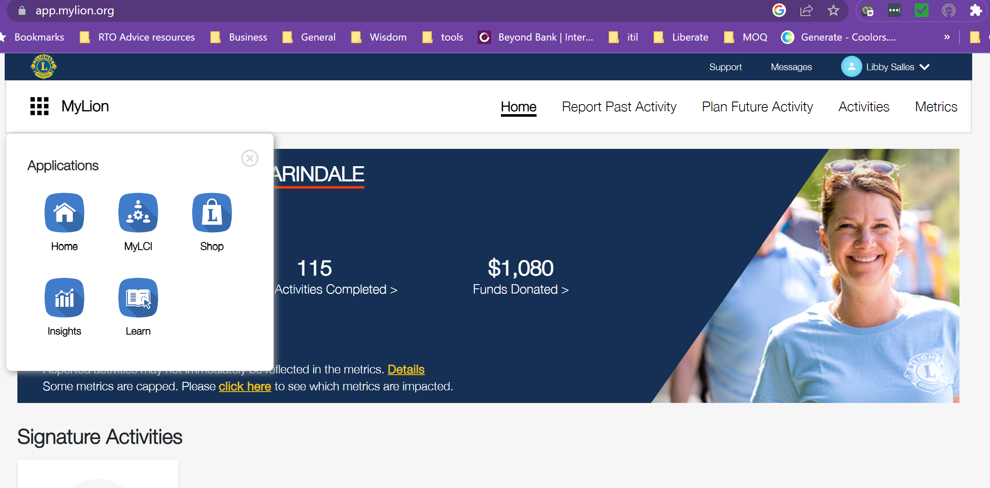
My Lion

Slide 23
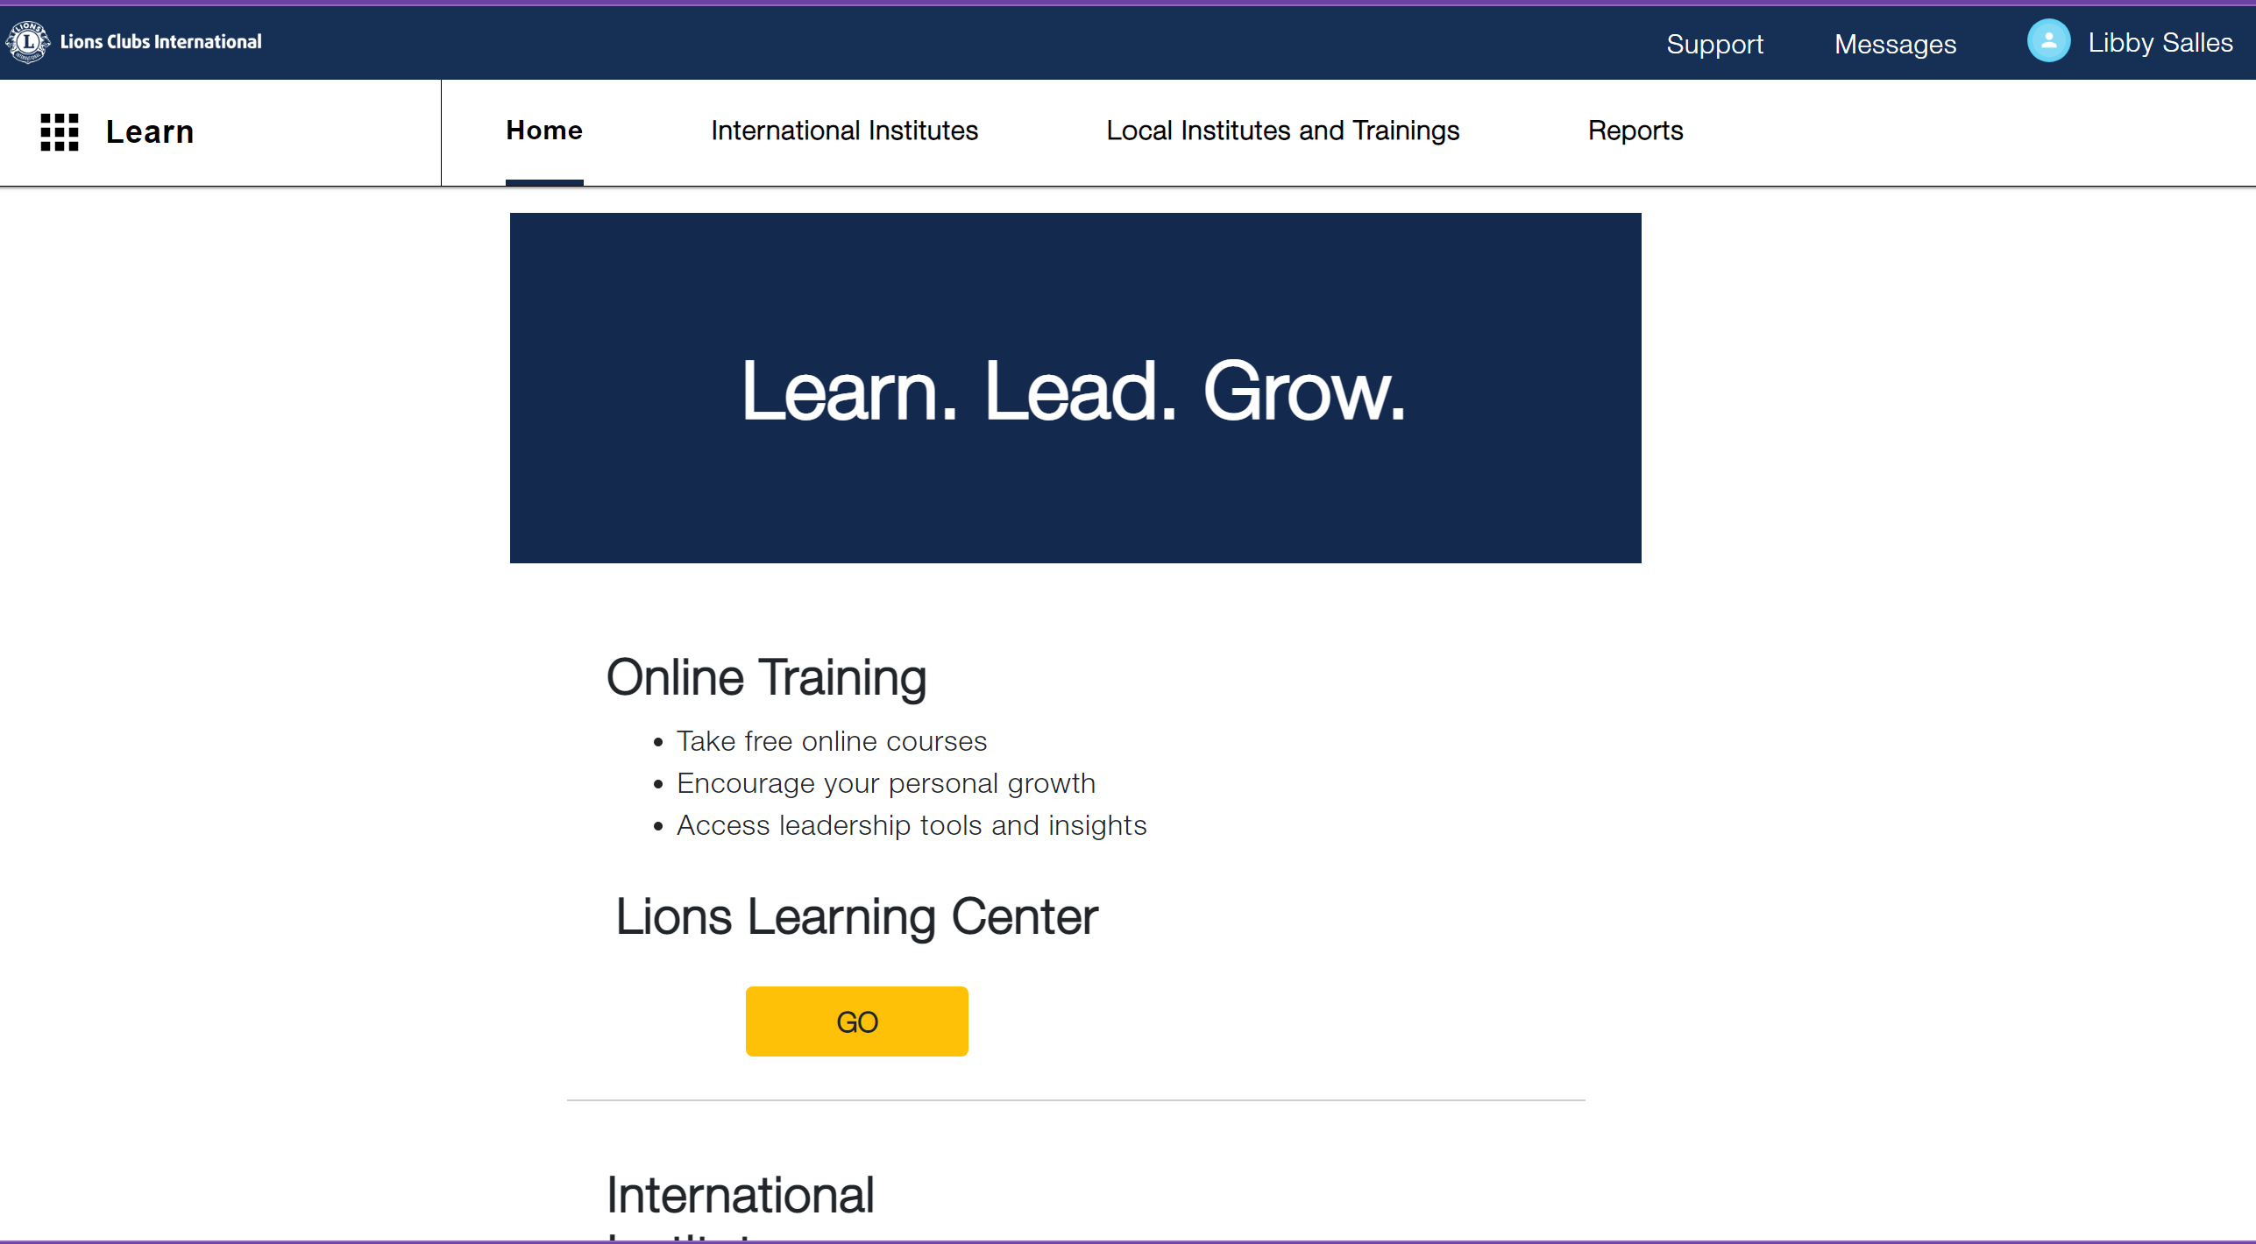
Lions learning centre

Slide 24
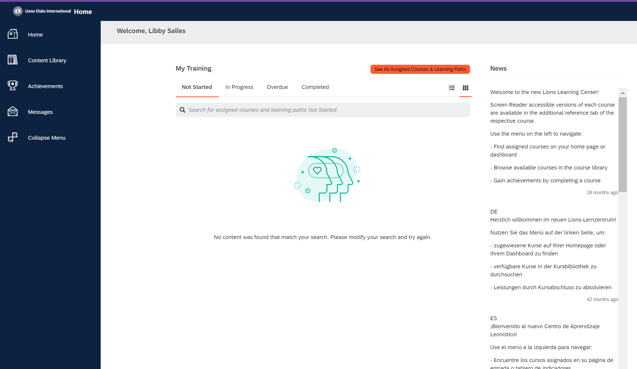
Content library

Slide 25

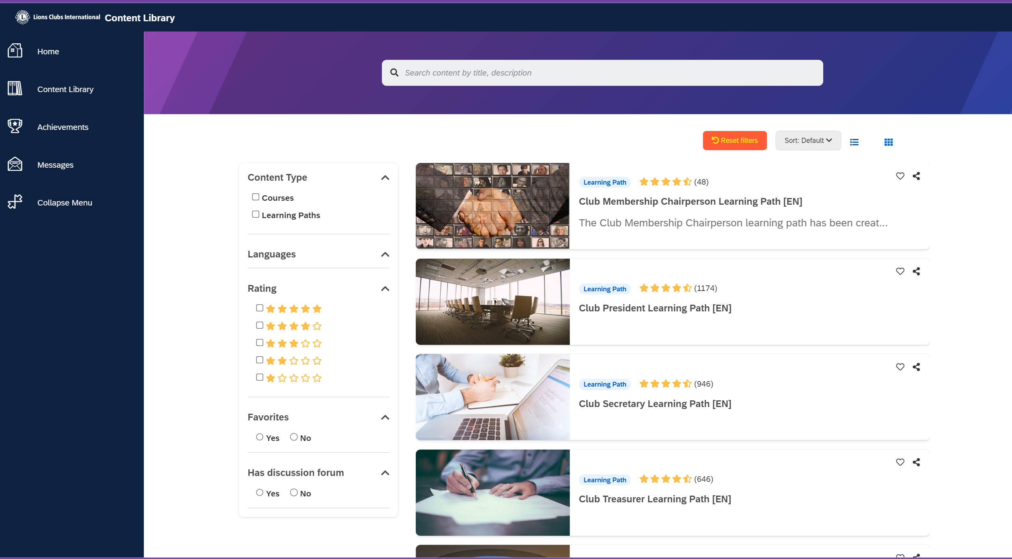
Search by course, path or topic

Slide 26
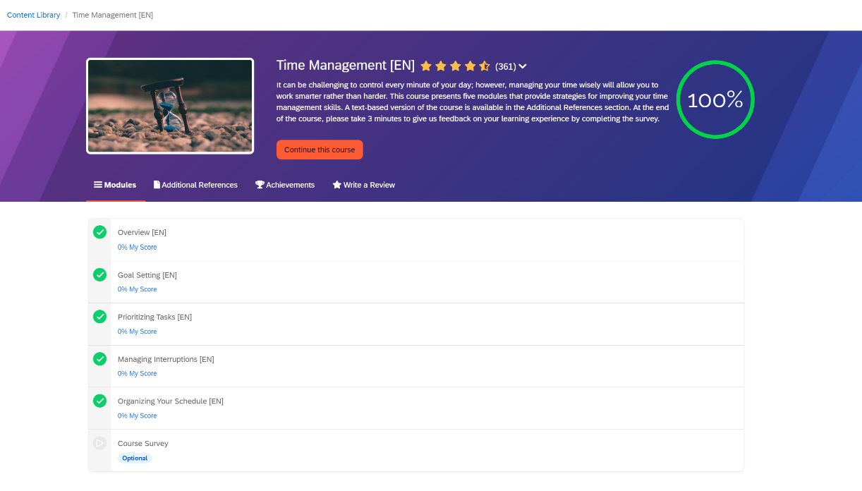
Time Management

Slide 27
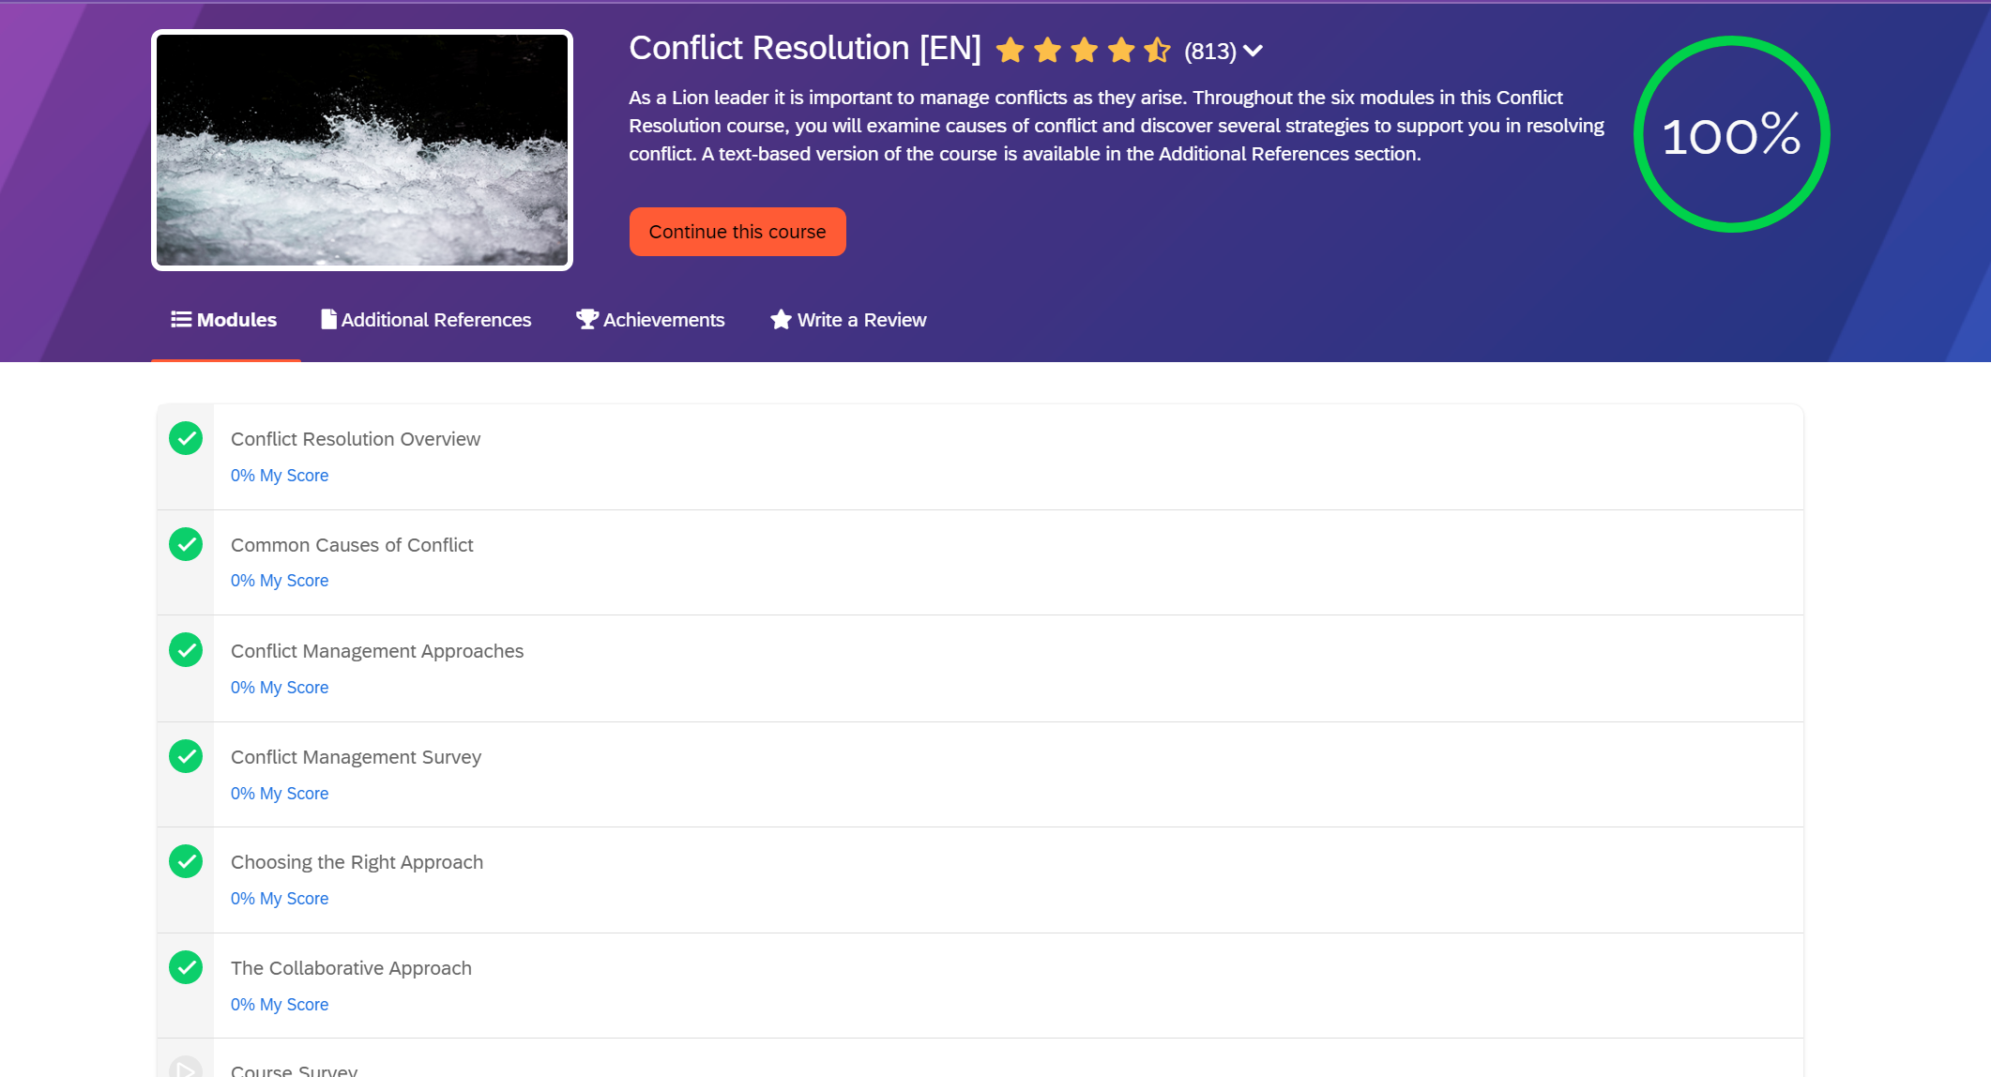
Conflict resolution

Slide 28
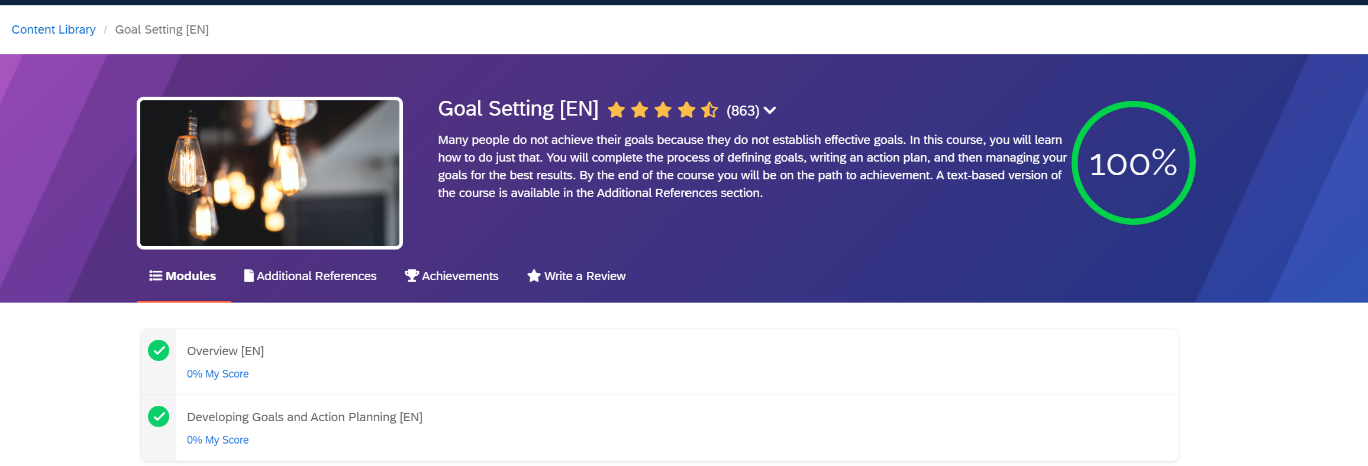
Goal setting

Slide 29
Thank You

